Slide 1

Choosing the Value of K in KNN
Understanding how the number of neighbors shapes your model's predictions and performance

Slide 2
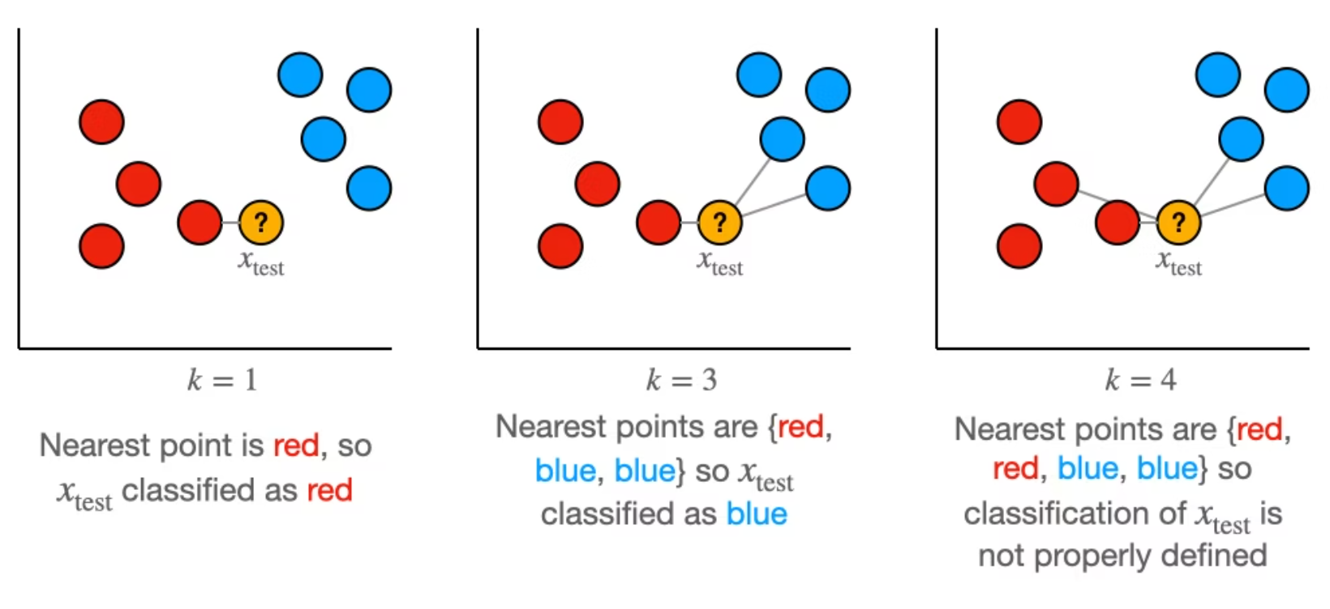
What Is K in K-Nearest Neighbors?
The value of K defines how many neighboring data points the algorithm considers when making a prediction. It's the fundamental parameter controlling how local or global your model's perspective becomes.
Think of K as adjusting a radius around each prediction point—smaller K means looking at just the closest neighbors, while larger K expands the circle to include more distant points in the decision.

Slide 3



Small K: High Sensitivity to Local Patterns
Noise Sensitivity
Complex Boundaries
Low Bias, High Variance
With few neighbors, even outliers can heavily influence predictions, making the model susceptible to random fluctuations in training data.
Decision boundaries become highly irregular and jagged, closely following individual training points rather than general trends.
The model makes few assumptions but varies dramatically with different training sets—classic overfitting behavior.

Slide 4
Large K: Stability Through Averaging
Noise Resistance
Smooth Boundaries
High Bias, Low Variance
By averaging over many neighbors, individual outliers have minimal impact. The model becomes robust to local anomalies and random variations.
Decision boundaries become gentle and regular, capturing only broad patterns while ignoring fine-grained details in the data.
Strong assumptions about smoothness lead to consistent predictions across datasets, but may miss important local structure—the hallmark of underfitting.

Slide 5


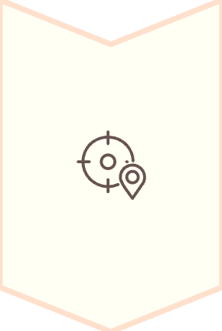
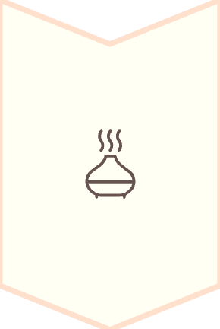
The Bias–Variance Tradeoff
Small K → Overfitting
Captures noise and irrelevant patterns. Excellent training performance but poor generalization to new data.
Optimal K → Balance
The sweet spot where the model captures true patterns without memorizing noise.
Large K → Underfitting
Oversimplifies the problem. Misses important relationships and performs poorly even on training data.

Slide 6
Starting Point: Rule of Thumb
√n Heuristic
Odd K for Binary Classification
Begin with K approximately equal to the square root of your sample size. For 10,000 training examples, start testing around K = 100.
Always use odd values of K when predicting between two classes to avoid ties in neighbor voting.
This provides a reasonable middle ground between local and global perspectives as a baseline for optimization.
For example, with K = 4, you could get 2 votes for each class. K = 5 ensures a decisive majority.

Slide 7
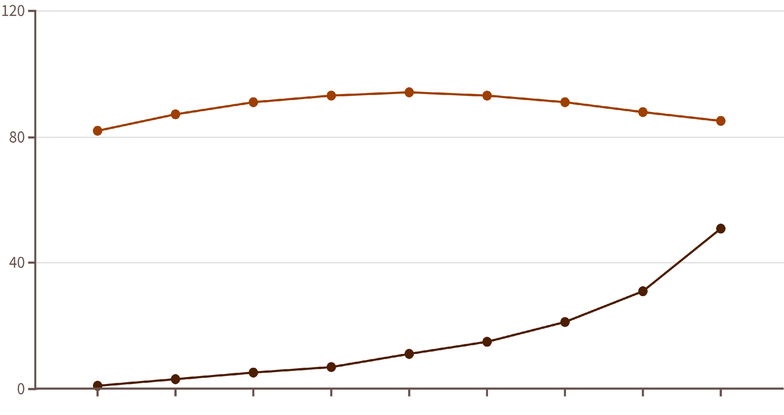
Finding the Best K Through Validation
The most reliable approach is systematic experimentation with held-out validation data. Test a range of K values and measure performance using a consistent metric like accuracy or F1-score.
K Value
Validation Accuracy
Look for the peak in validation performance—this represents the optimal balance. The curve typically shows improvement from very small K, reaches a maximum, then declines as K grows too large.

Slide 8
Practical Guidelines for Success
01
02
Never Assume a Universal K
Always Validate with Unseen Data
Different datasets have different optimal values. The best K for one problem may perform poorly on another due to variations in noise levels, feature scales, and class distributions.
Use cross-validation or a held-out validation set. Testing multiple K values on training data alone will mislead you toward overfitting.
03
04
Consider Computational Cost
Monitor Both Metrics
Larger K values require more distance computations at prediction time. Balance accuracy gains against inference speed requirements for your application.
Track training and validation performance together. A large gap signals overfitting; poor performance on both suggests underfitting or data quality issues.

